Slide 1
EV and HEV
(Part of UNIT-2, FME (BME101))
By
Dr. Pratishtha Sharma
Assistant Professor, ME Department
ABES Engineering College, Ghaziabad

Slide 2
EV (Electric Vehicle)
Electric vehicles consists of an electric motor that is powered by a battery pack. The main advantage of electric vehicles is that they emit zero emissions and are eco-friendly. They also do not consume any fossil fuels, hence use a sustainable form of energy for powering the car.

Slide 3
Types of EVs
BEV (battery Electric Vehicle) : Also called as fully electric vehicles or ‘All Electric Vehicles’. They have only electric motor powered by on board batteries for propulsion. They don’t have patrol/diesel engine, fuel tank etc. Batteries are rechargeable and are charged from external source.
HEV
Plug-in HEV (PHEV)
Fuel Cell EV

Slide 4
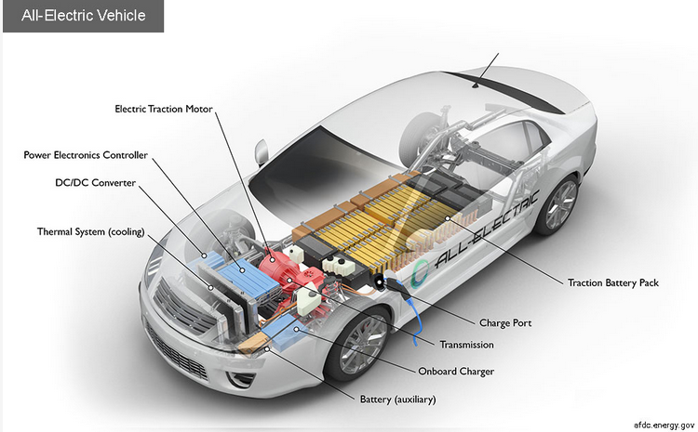

Slide 5
Power Transmission Process in EV
Power transmission in electric vehicles (EVs) involves the transfer of electrical energy from the energy source (usually a battery) to the electric motor that drives the vehicle.
the power transmission in electric vehicles is more straightforward compared to traditional internal combustion engine vehicles.
There is no need for a complex gearbox or transmission.
The electric powertrain is more efficient, with a direct connection between the battery, power electronics, and the electric motor.

Slide 6
Key components in Power Transmission
The key components involved in power transmission in electric vehicles are-
Battery
Power electronics (Invertor, converters and controllers)
Electric motor
Transmission System (if applicable)
Drive Shaft
Wheels
The details of each of these key components are given ahead:

Slide 7
1) Battery
The primary energy source in electric vehicles is the battery. The battery stores electrical energy in the form of chemical energy and provides power to the electric motor. Lithium-ion batteries are commonly used in electric vehicles due to their high energy density and relatively lightweight.

Slide 8
2) Power electronics (Invertor, converters and controllers)
Power electronics are crucial in converting the direct current (DC) stored in the battery into the alternating current (AC) needed to drive the electric motor. The power electronics system typically includes an inverter, which is responsible for converting DC to AC, and other components like converters and controllers that manage the flow of electrical energy.
Inverter: The inverter is a key component in power transmission. It takes the DC power from the battery and converts it into AC power, which is then supplied to the electric motor. The inverter controls the frequency and amplitude of the AC power, allowing for precise control of the electric motor.

Slide 9
3) Electric motor
The electric motor is what actually drives the vehicle. There are different types of electric motors used in EVs, including induction motors and permanent magnet motors. These motors convert electrical energy into mechanical energy, propelling the vehicle forward.

Slide 10
4) Transmission System (if applicable)
Some electric vehicles, especially those with multiple motors or specific performance requirements, may have a transmission system. However, most of the electric vehicles use a single-speed transmission or even direct drive, as electric motors can provide a wide range of torque and speed without the need for complex multi-speed transmissions.

Slide 11
5) Drive Shaft and 6) Wheels
5. Drive Shaft: The power generated by the electric motor is transmitted to the wheels via a drive shaft. In some cases, electric vehicles may have individual motors for each wheel, eliminating the need for a traditional drive shaft.
6. Wheels: The final step in power transmission is the mechanical power being transferred from the drive shaft to the wheels, causing the vehicle to move.

Slide 12
Advantages of BEV
Environmental Benefits:
Zero Emissions: BEVs produce no tailpipe emissions, reducing air pollution and greenhouse gas emissions, contributing to improved air quality and mitigating climate change.
Renewable Energy Integration: When charged using renewable energy sources, BEVs can be part of a cleaner and more sustainable transportation system.
Energy Efficiency:
Higher Efficiency: Electric motors are generally more efficient than conventional internal combustion engines, resulting in higher energy efficiency and lower energy waste during operation.
Lower Operating Costs:
Lower Fuel Costs: Charging an electric vehicle is often cheaper than fueling a traditional gasoline vehicle, leading to potential cost savings over time.
Reduced Maintenance: BEVs typically have fewer moving parts and require less maintenance compared to internal combustion engine vehicles.

Slide 13
Advantages of BEV (Continued…)
Quiet Operation:
BEVs operate more quietly than traditional vehicles, contributing to reduced noise pollution in urban areas.
Instant Torque:
Electric motors provide instant torque, leading to quick acceleration and a responsive driving experience.
Reduced Dependency on Fossil Fuels:
BEVs reduce reliance on fossil fuels for transportation, contributing to energy diversification and energy security.

Slide 14
Disadvantages of BEV
Limited Range:
BEVs typically have a limited driving range on a single charge compared to traditional vehicles. Range anxiety, or the fear of running out of battery power, can be a concern for some consumers.
Charging Infrastructure:
The charging infrastructure for electric vehicles is still developing, and widespread charging stations may not be as readily available as traditional gas stations, especially in some regions.
Charging Time:
Charging a battery takes longer than filling a gas tank. While fast-charging technologies are improving, long charging times can be inconvenient for some users, especially on long trips.
Upfront Cost:
The initial purchase price of BEVs is often higher than that of traditional vehicles, primarily due to the cost of the battery. However, this cost difference may be mitigated over time by lower operating costs.

Slide 15
Disadvantages of BEV (Continued…)
Battery Degradation:
Over time, the performance of batteries in BEVs can degrade, affecting the driving range and overall efficiency. Battery replacement costs can be a concern for some owners.
Limited Model Variety:
While the variety of electric vehicle models is increasing, there may still be fewer options compared to traditional vehicles in terms of body styles, sizes, and features.
Weight and Performance Trade-offs:
The weight of the battery pack can impact the overall weight of the vehicle, potentially affecting performance and handling.
It's essential to note that the landscape of electric vehicles is rapidly evolving, and ongoing advancements in technology, infrastructure, and policy may address some of the current disadvantages over time.

Slide 16
Futuristic Innovations in All Electric Vehicles
As competition fosters innovation and further research, here are some of the latest technological breakthroughs that scientists working on. Each has the potential to be the next big thing for the EV industry and give it the big push forward :
Different (newer) battery technology
Improving battery range and life
Wireless charging
Ultra-fast charging
Battery swapping
Apart from the above mentioned futuristic innovations, the public is waiting to see rapid growth in the fields of :
Travel range, Safety ratings, Performance, Aesthetics, Affordability, Automation.

Slide 17
Hybrid Electric Vehicles
A Hybrid Electric Vehicle is a type of vehicle that uses a combination of an Internal Combustion (IC) engine and an electric propulsion system. The electric powertrain may enhance fuel efficiency, increase performance, or independently propel the vehicle on pure electric power, depending on the type of hybrid system.
In simple words, an HEV is a vehicle that comprises a conventional fuel engine and an electric powertrain, wherein the electric motor assists the engine to extract more performance, and better fuel economy, depending on the type of the system.

Slide 18
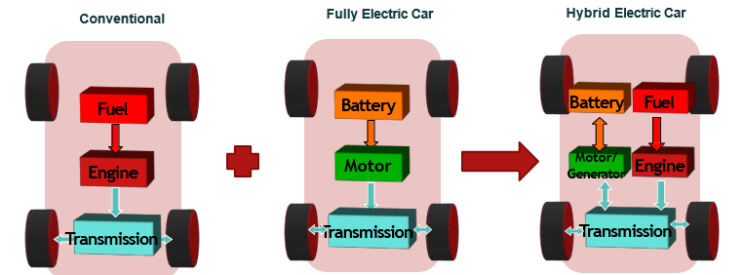
HEVs

Slide 19
Advantages of HEVs
Fuel Efficiency
Fuel saving
Reduced Emissions
Regenerative Braking
Idle stop function
No Range Anxiety
Smooth Transition Between Power Sources
Lesser noise pollution
Well-Established Technology
Can be driven entirely on electric power for some time, in some models.

Slide 20
Disadvantages of HEVs
Limited Electric-Only Range
Dependency on Gasoline
Complexity of parts and complexity in maintenance
Higher maintenance cost
Initial Cost
Limited Charging Infrastructure
Battery Degradation over time
Batteries eat-up space

Slide 21
Levels of Hybridization in HEVs
There are three levels of hybridization in HEVs:
Mild or micro hybridization
Medium hybridization
Full hybridization

Slide 22
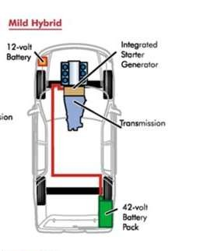

Level of Hybridization
5
A small motor/generator usually taking the place of a conventional alternator.
They feature idle-stop function (i.e. automatic turning off the engine when vehicle is not moving).
Utilize Regenerative braking (using kinetic energy of a stopping car to charge the car-battery, by converting its electric motor into a generator or dynamo).
Are not capable of using electric motor alone to propel the vehicle.
Battery is usually 42 volts or less.
Cheaper hybrid system as comparative to medium hybrid.
Fig: Mild Hybridization
Image Source: Google Images

Slide 23


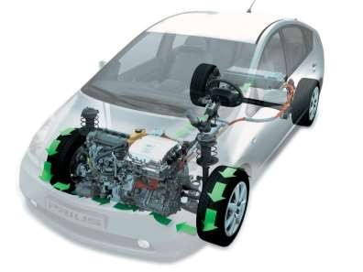

Level of Hybridization
6
A small motor/generator usually taking the place of a conventional alternator.
They also feature idle stop feature.
Utilize Regenerative braking.
Most are not capable of using electric motor alone to propel the vehicle.
motor/generator only delivers drive under heavy acceleration or to give the engine a helping hand from a standing start, to ensure fuel economy.
Battery is usually 144 to 158 volts.
Cheaper than fully hybrid.
Fig: Medium Hybridization
Image Source: Google Images

Slide 24
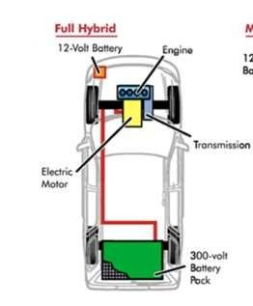

Level of Hybridization
7
They feature idle-stop feature.
Fully active regenerative braking.
Capable of using the electric motor alone to propel the vehicle.
The electric motor also assists the engine.
Battery are usually 200-300 volts.
Costlier than previous two types of hybrids.
Fig: Full Hybridization
Image Source: Google Images

Slide 25
Types of Hybridization in HEVs
Based on their working/operating principle, there are three types of hybrid electric vehicles available in the market-
Series hybrid
Parallel hybrid
Series/parallel or mixed or compound hybrid

Slide 26
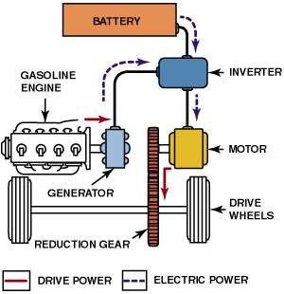
Types of Hybrid
8
1. Series hybrid
◆ The fuel tank goes to the engine, but the engine turns a generator.
◆ Then the generator can either charge the batteries or power an electric motor that drives the transmission.
◆ The gasoline engine does not directly
power the car.
This hybrid system works well specially for fuel economy at low speeds.
Fig: Series Hybrid
Image Source: Google Images

Slide 27
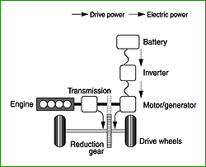
Types of Hybrid
2. Parallel hybrid
◆ In a parallel hybrid system, both the engine and the electric motor drive the wheels, and the drive power from these two sources can be utilized according to the prevailing conditions. This is called a parallel hybrid system because the power flows to the wheels in parallel.
Fig: Series Hybrid
Image Source: Google Images

Slide 28
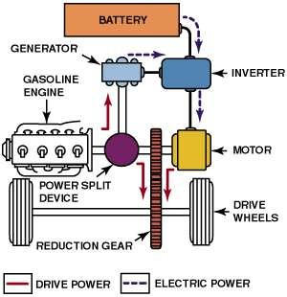
Types of Hybrid
3. Series/Parallel Hybrid (Mixed or Compound hybrid)
◆ Has a fuel tank that supplies gas/fuel to the engine like a regular car.
◆ It also has a set of batteries that run an
electric motor.
◆ Both the engine and electric motor can turn the transmission at the same time.
◆ Parallel type also called Power-split hybrids.
◆ More beneficial then above hybrid.
◆ Most of the latest vehicle based on this hybrid.
Fig: Parallel Hybrid
Image Source: Google Images

Slide 29
Difference between EV and HEV
the main difference between EVs and HEVs is that EVs operate solely on electric power and require external charging, while HEVs use a combination of an internal combustion engine and electric power, with the battery charged through the vehicle's operation and no external plug-in charging required.
Each technology has its advantages and considerations depending on the user's driving patterns, charging infrastructure, and environmental preferences.

Slide 30
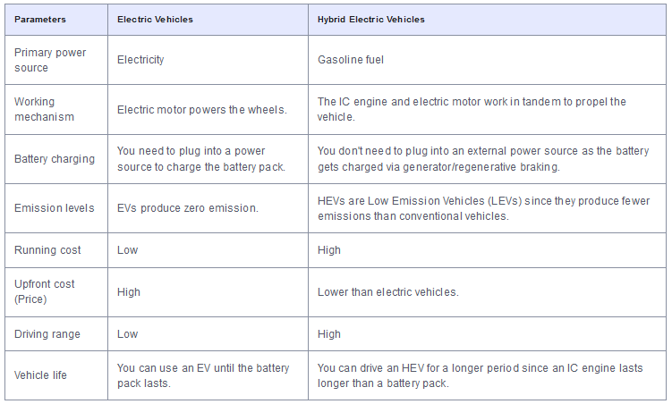
Comparison between EVs and HEVs

Slide 31
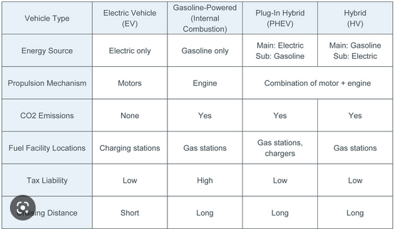
Comparison of EV, HEV and Conventional Vehicles

Slide 32
Some of the popular HEVs in India
Toyota Prius
Toyota Innova Hycross
Various Lexus models
Mitsubushi Outlander (FHEV)
Maruti Grand Vitara
Ford Escape Hybrid (FHEV, an SUV), Ford Fusion Hybrid (FHEV)
BMW i3 (Series HEV), BMW 7 series (MHEV with high output motor)
Mercedes-Benz S400 Blue Hybrid
Toyota Camry Hybrid,
Honda Civic Hybrid (MHEV),
Honda Accord hybrid
Ferrari A1(Special Mild HEV, with specialized high-output electric motor)
Volkswagen Jetta Hybrid (FHEV)
Chevrolet Silverado (MHEV)

Slide 33
Some of the popular EVs in India (2w and 4w)
Tata Nexon EV
MG ZS EV
Hyundai Kona Electric
Mahindra eVerito
Ather 450X
Revolt RV400
Bajaj Chetak Electric
Mercedes-Benz EQC
Audi e-tron

